Slide 1

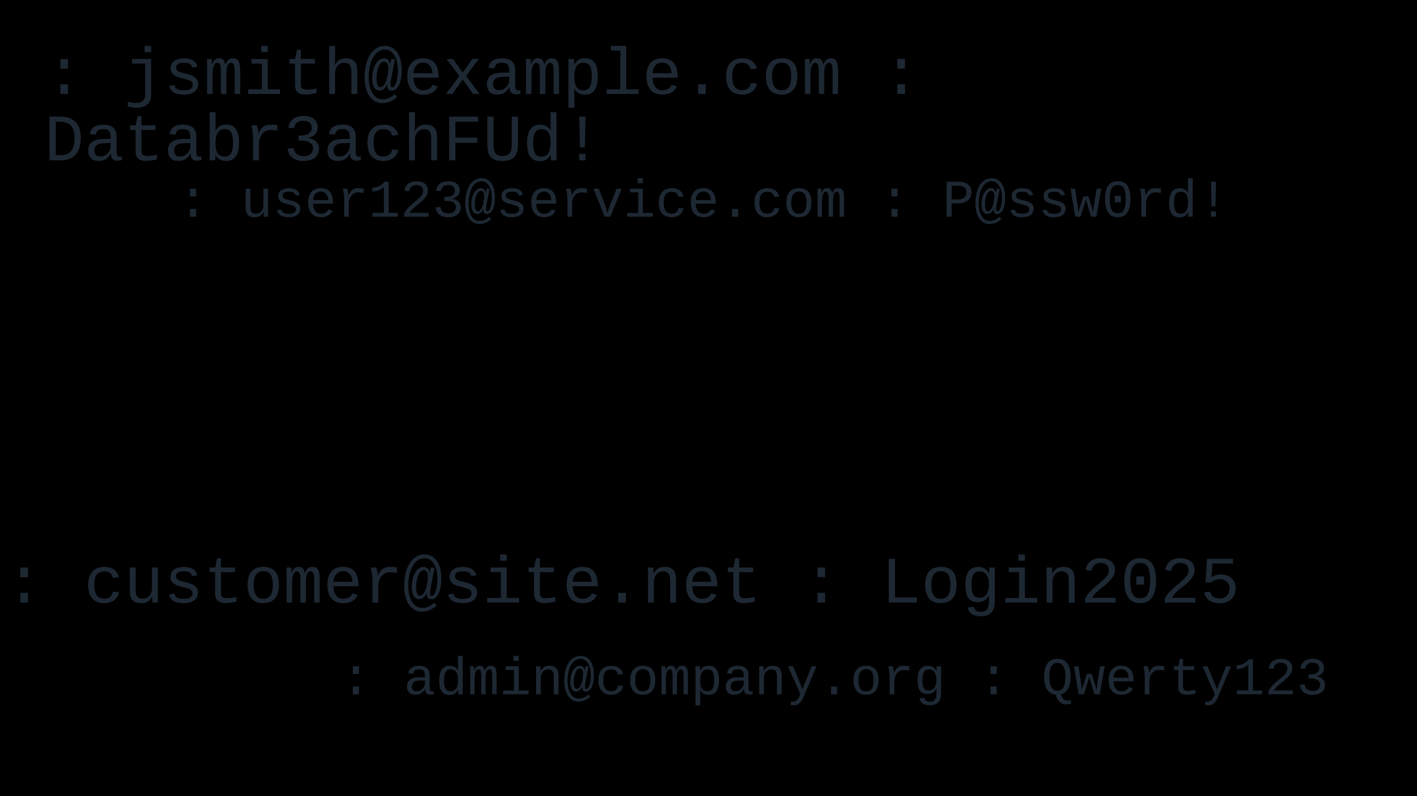

MASS CREDENTIAL EXPOSURE
Apple • Google • Facebook
Case Study Group Presentation
CEP146NDD
Report Date: 2025-10-14

Slide 2








Objective
Research Focus
Our research focuses on a major cybersecurity incident:
16-Billion Credential Leak
Discovered in June 2025 across 30+ datasets on the dark web
Note: The 16-Billion figure is an aggregate and includes duplicates and recycled data from older breaches (see criticism).
Analyze the Incident
Assess Implications
Transition Analysis
Examine the origins and scale of the credential leak, understanding how 85% came from infostealer malware and 15% from older breaches
Evaluate risks including credential stuffing, identity theft, and impact on user trust for major platforms
Monitor industry shift toward passwordless authentication, with focus on passkeys adoption (550% increase reported)
"Understanding this event provides critical insights into modern authentication security challenges"
2/8

Slide 3






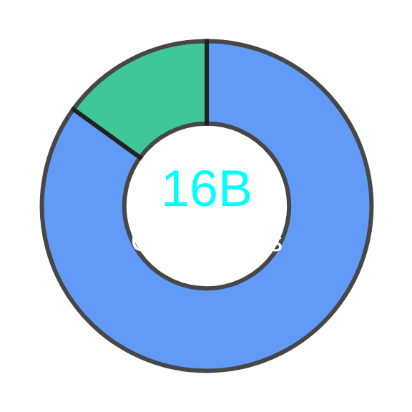













What Happened - The 16-Billion Credential Leak
June 2025
This figure is an aggregate of data from 30+ dark web datasets, including older and duplicate entries.
Event Overview
Source of the Leak
16 billion records exposed across ~30 datasets on the dark web
Key insight: Major tech companies (Apple, Google, Facebook) were not directly hacked — their users' data appeared in compilations
Example Format
: jsmith@example.com : Databr3achFUd!
Affected Companies
Infostealer Malware (85%)
Older Breaches (15%)
Infostealer malware covertly siphons login credentials, browser cookies, and authentication tokens from infected systems
Apple
Google
Facebook
Note: Companies were not directly breached, but their users' data appeared in aggregated datasets
3/8

Slide 4












Risks & Implications
Security & Business Impact
For Users
For Businesses
Credential Stuffing Attacks
Operational Costs
Attackers reuse compromised credentials to access other accounts. 0.1% of breached credentials can lead to successful logins.
Investigation, incident response, and compliance with regulations like GDPR. Companies must notify affected users.
Identity Theft & Fraud
Loss of User Trust
Personal details used to commit identity theft, open fraudulent accounts, and impersonate individuals.
Erosion of customer trust and significant reputational damage when user credentials are exposed.
Targeted Phishing
Increased Attack Surface
Attackers craft personalized phishing emails using leaked information to increase effectiveness.
Companies must assume their users' passwords are compromised, requiring enhanced security measures.
"Even companies not directly breached face significant implications when their users' data appears in these leaks."
4/8

Slide 5





Developer & Design Lessons
Secure Credential Handling
Secure Storage
Password Hashing
Never store plain-text passwords. Use strong hashing algorithms like bcrypt
🛡️ Authentication Resilience
- Enforce Multi-Factor Authentication (MFA): Make MFA the default or mandatory for all users.
- Integrate Breach-Detection APIs: Use services to check if user credentials have appeared in known breaches.
- Educate Users via Clear Design: Use clear prompts to guide users on strong password hygiene and MFA setup.

Slide 6
























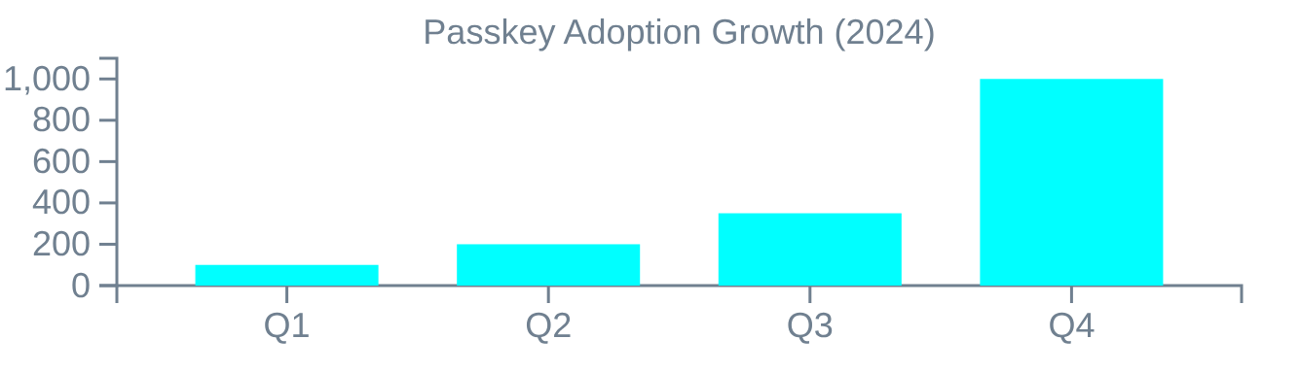
Passwordless / Passkeys
Authentication Evolution
Industry Shift
Two Passkey Approaches
Major players like Microsoft and Google leading the transition to passwordless authentication
Device-bound Passkeys
Stored on a single physical device
More secure
Local authentication
Microsoft
Google
Apple
Key never leaves device
Biometrics or PIN
Synced Passkeys
Passkey Adoption
Synchronized across devices
550%
Multi-device access
Balance security
Portable across ecosystem
Convenient user experience
Increase in daily passkey creation (Bitwarden, 2024)
"Passwordless authentication represents the future of secure and user-friendly access"
Over a million new passkeys generated in Q4 2024 alone
6/8

Slide 7










Criticism & Balanced View
A Balanced Perspective
While the 16 billion credential leak presents concerning data, it's important to consider multiple perspectives
Criticism
Balanced View
Inflated Numbers: The 16 billion figure may be artificially bloated by inclusion of duplicates and recycled data from older breaches
Systemic Weaknesses: Even with potential overestimation, the incident exposes fundamental vulnerabilities in traditional password-based security models
Not New Data: A significant portion came from older, previously known breaches rather than representing entirely new compromises
User Awareness: Highlights the urgent need for enhanced user education regarding credential hygiene and password management
Questionable Attribution: The direct connection to Apple, Google, and Facebook may be tenuous, as their systems weren't directly breached
Transparent Reporting: Organizations need to adopt more transparent practices when reporting data breaches and their origins
"Even if the numbers are overstated, the event still reveals serious security flaws in our digital infrastructure"
7/8

Slide 8







Summary
Key Takeaways
The Incident
Developer Best Practices
16 billion credentials exposed across 30+ datasets
Implement strong hashing (bcrypt, Argon2) with salts
85% from infostealer malware, 15% from older breaches
Enforce multi-factor authentication (MFA)
Affects users of major platforms (Apple, Google, Facebook)
Integrate breach-detection APIs
Apply secure coding practices (validation, encryption)
Educate users through clear design
Associated Risks
Credential stuffing attacks (0.1% can lead to successful logins)
Future of Authentication
Identity theft and fraud using personal information
Targeted phishing campaigns with personalized lures
Shift toward passwordless authentication
Operational costs for investigations and compliance
550% increase in passkey creation reported
Loss of user trust and brand damage
Two main passkey types: device-bound and synced
Balance of security and convenience
"The road to secure authentication lies in combining technical innovation with user-centered design."
8/8

